Slide 1
MAVS ICECREAM
EMPORIUM
-Nishad Aherrao

Slide 2
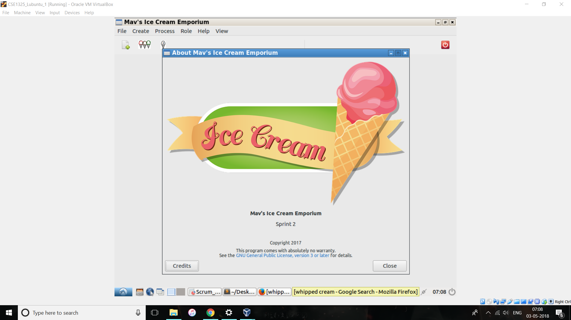
Clean and Simple Interface:
Save Training cost by using our easy minimalistic interface

Slide 3
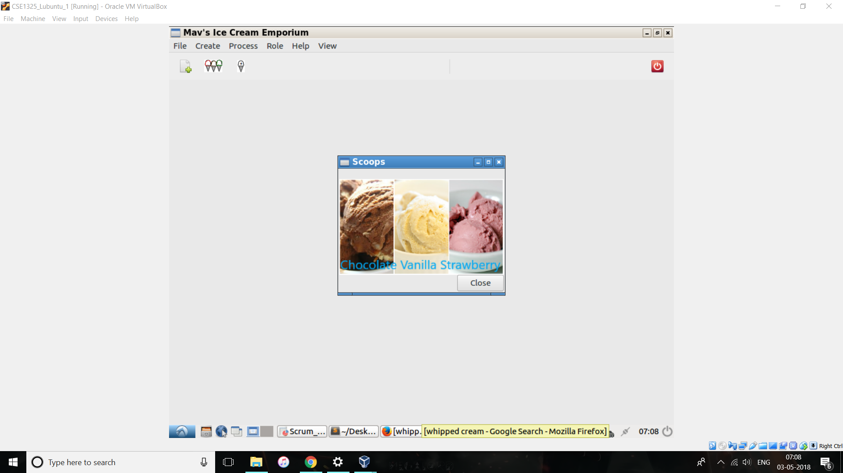
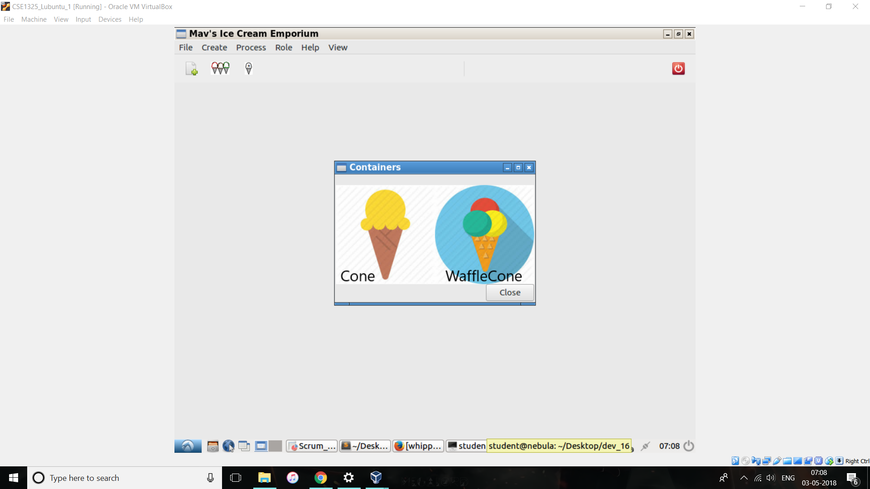
Make your Customers Happy
Don’t make them feel like they are getting scammed show them what they are getting before ordering

Slide 4
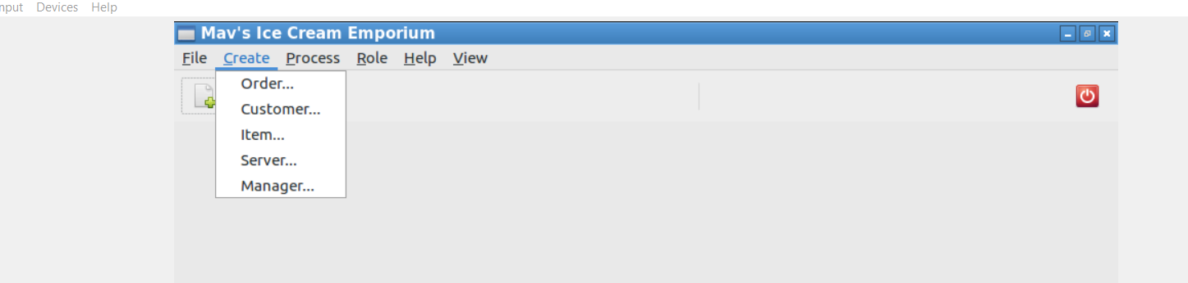
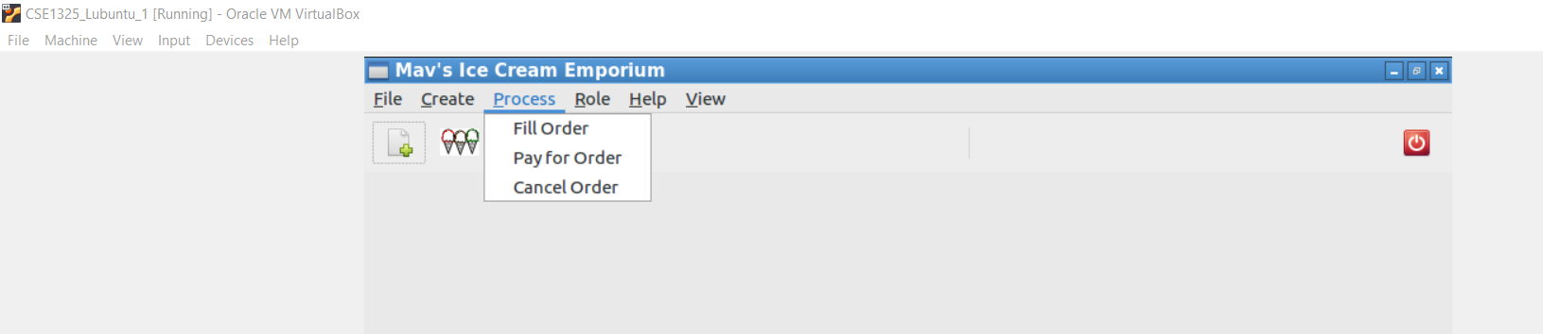
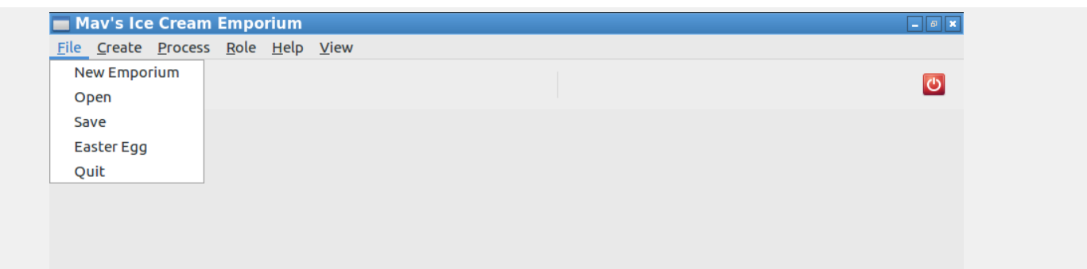
Tons of options:
1.Save Your emporium before closing the shop and come back the next day without anything to worry about we will resume
where you left the other day.
2.Create new items or people entries anytime afterall we support your growth.

Slide 5
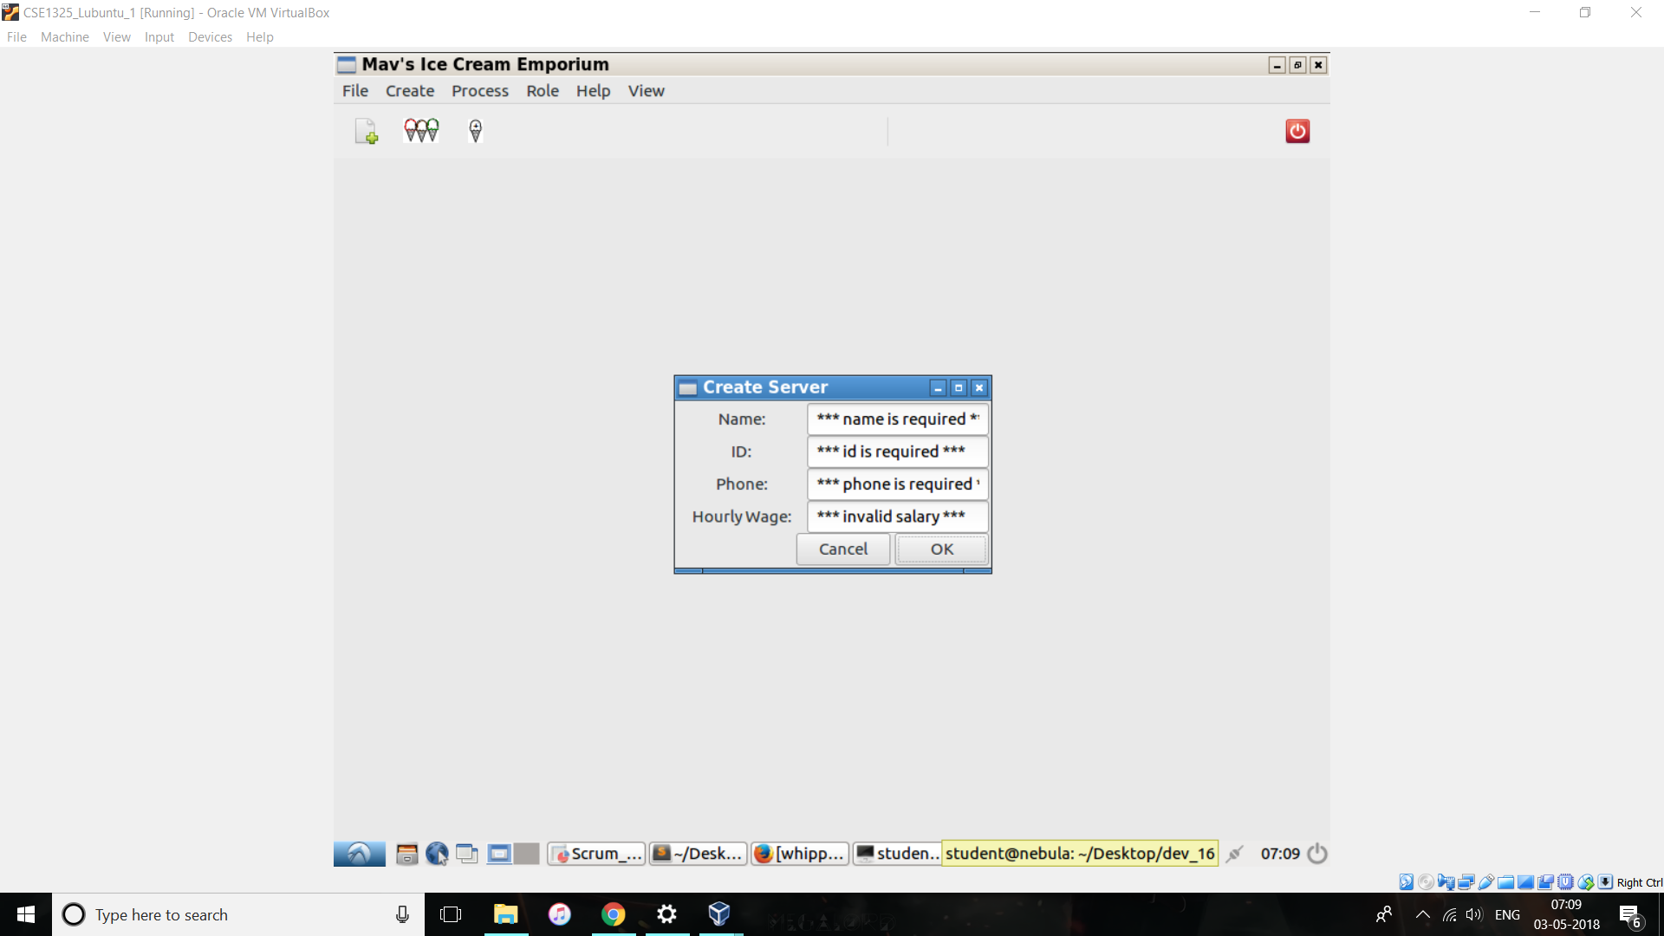
Don’t let the Bugs bite:
We have made sure to check everything so you can have a peace of mind

Slide 6
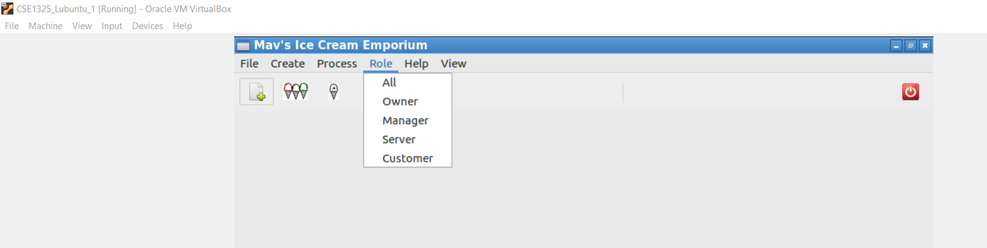
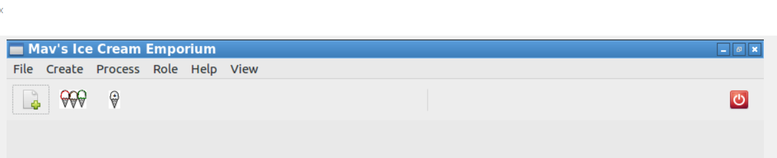
Multiple clearance levels available
Tired of dropdown lists use our toolbar

Slide 7
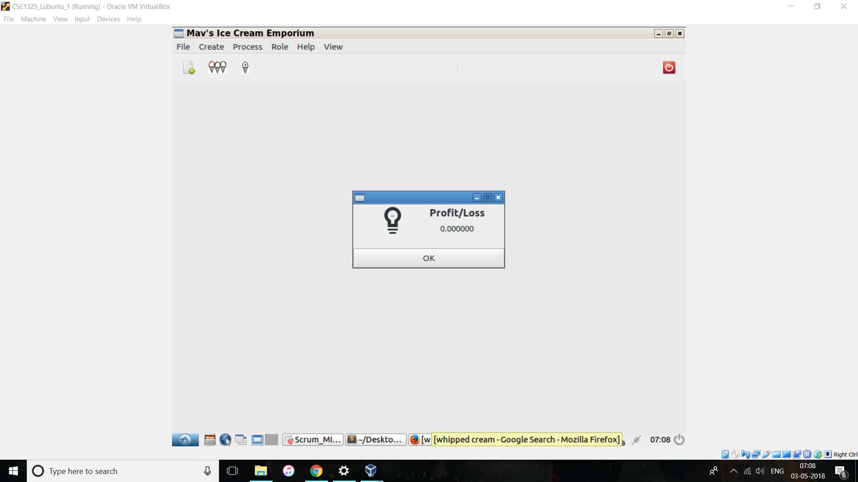

We hope you liked our effort! Always ready to make changes and help you out in starting your business.
Its more than just a program afterall it helps serve Ice-Cream!!!!
Finally do remember to check your statement every day!
Profit? Loss? We got it covered!

